Slide 1

Customer
Credit Risk
Analysis
Bank of Questrom
Notes:
Neri

Slide 2
Table of Contents
Introduction
Methodologies
Conclusion
1
3
5
2
4
6
Dataset
Analysis
Appendix
Notes:
Neri

Slide 3

1.
Introduction
Bank of Questrom
Notes:
Anshi

Slide 4

Bank of Questrom
Financial Product ‘BA305’ Timeline
Successful
Marketing
Launched
Product
Internal Credit Evaluation Failure
Urgent Need for
Credit Risk Evaluation!
JAN
FEB
MAR
APR
MAY
JUN
JUL
Failure of
Credit Bureaus
Received
Applications
Deadline for
Decision
Notes:
Anshi

Slide 5






Credit Risk Analyst Team
BA 305 Team Only One
Anshi Mittal Data Scientist
Michelle M. Lu Business Analyst
Neri A. Arreaga Data Analyst
David E. Kim B.I. Engineer
Notes:
Neri

Slide 6
What are the most important features in classifying someone with high credit risk?
Notes:
Neri

Slide 7
What are the characteristics of an average customer with low or high credit risk?
Notes:
Neri

Slide 8
What are the optimal benchmarks for the application approval and rejection?
Notes:
Neri

Slide 9

2.
Dataset
Bank of Questrom
Notes:
Anshi

Slide 10
100,000 Observations
8 Months For All 12,500 Unique Clients
Notes:
Anshi

Slide 11

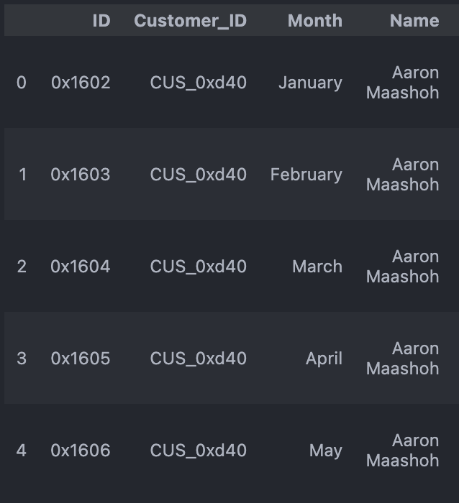
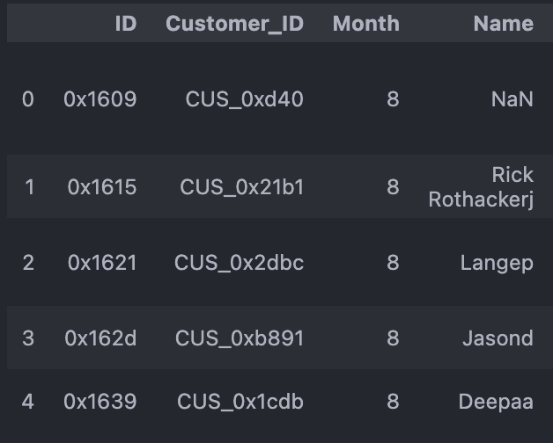
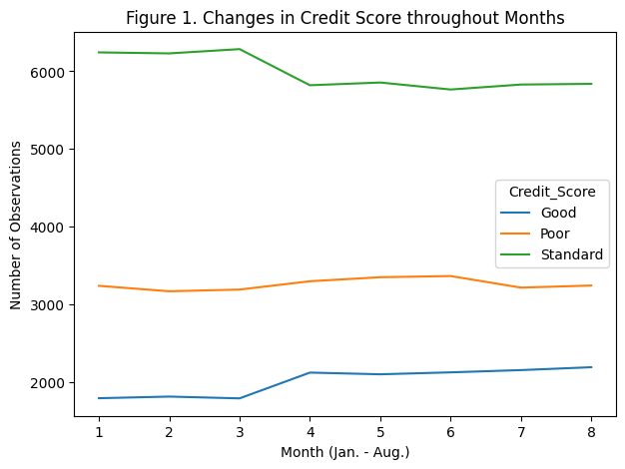
Data Type
Before
Pooled Data
*Time Series + Cross Section
After
Cross Sectional Data
*Remove Time Series (Months)
Notes:
Anshi *repetition of similar data. No change in credit score amongst the months with same individual so not much fluctuation

Slide 12
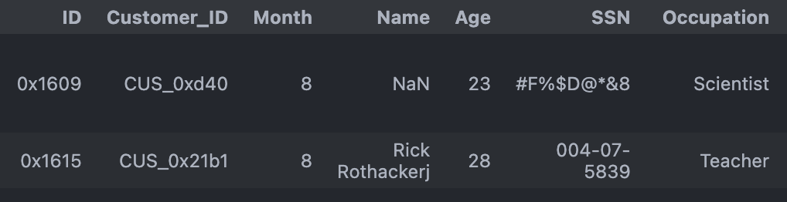
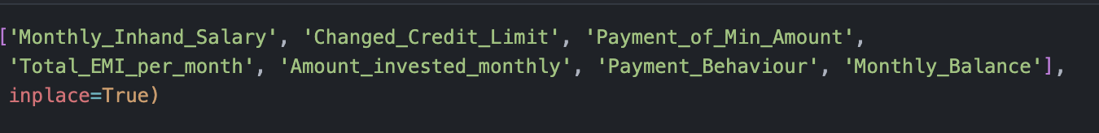
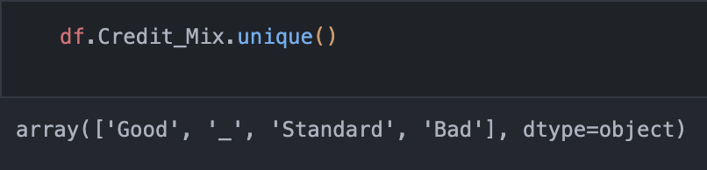
Data Pre-processing
Feature Selection
Drop
Identification variables
Time related variables
‘Occupation’ variable
Missing Values
Removed
NaN values
.dropna()
‘_’ values
manual removal
Notes:
Anshi – overfit model with occupation 15 dummy variables
– removed nan values and underscore values as proposed missing values

Slide 13
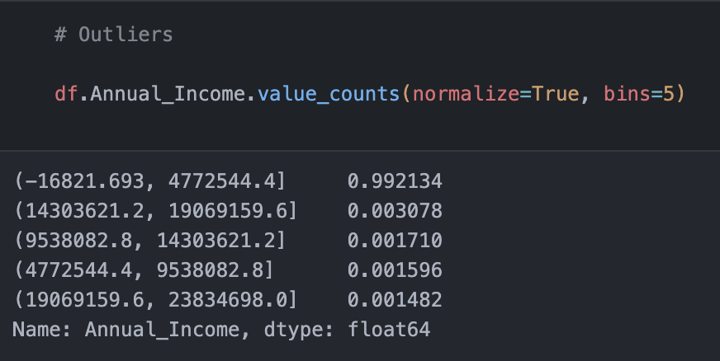
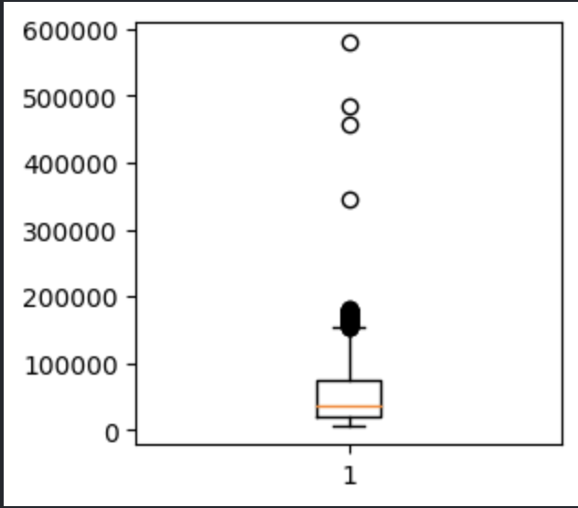
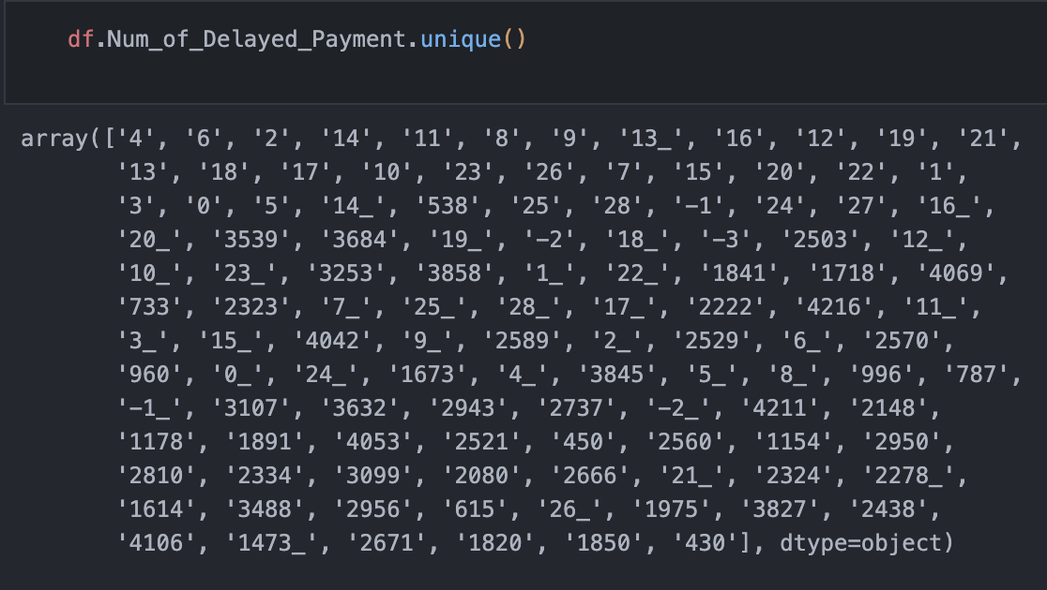
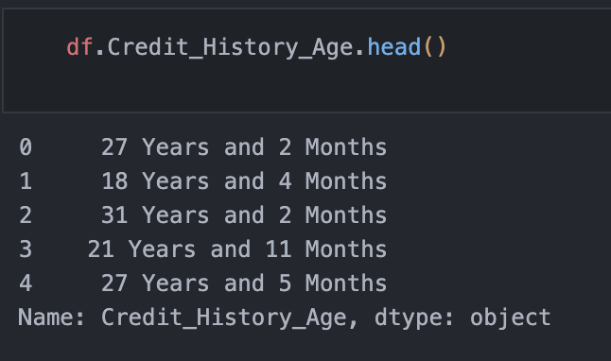
Data Pre-processing
Reformatting
String to Integer and Floats
Remove non-numeric chars.
00 Years and 00 Months
Recalculation to Months
Outliers
Removed the outliers that represent approximately 1% of the data in the columns.
Notes:
Anshi – for example, through further analysis of box and whisper plot where we can see that outliers extended to 400,000 however our range extended to mainly 200,000 annual income. Removed only 1% of the data so did not dramatically remove the data

Slide 14
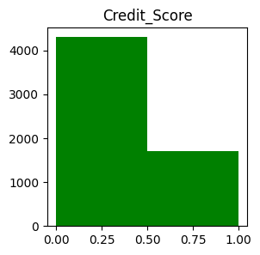
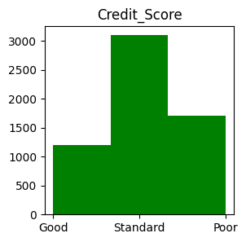
Data Pre-processing
Dependent Variable
Decision Tree
0: Good & Standard
1: Poor
K-Means Clustering
Good
Standard
Poor
Notes:
Anshi – two different versions of the dependent variable where in decision trees the good and standard scores were combined. Main purpose was to predict poor credit score so worked better for our model.
K-Means clustering involved three separate variables to find the average characteristics of each class since the centroids in the clusters would provide averages for the

Slide 15
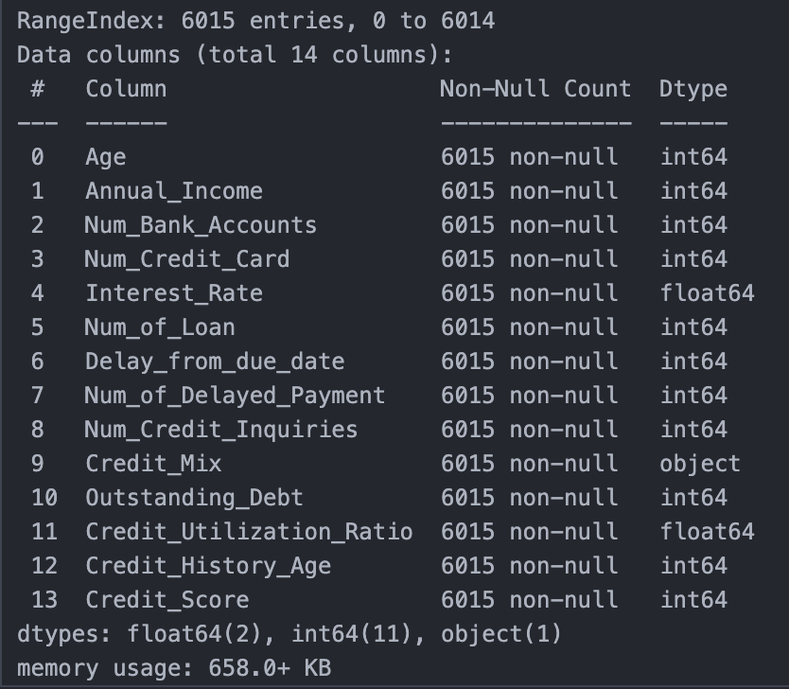
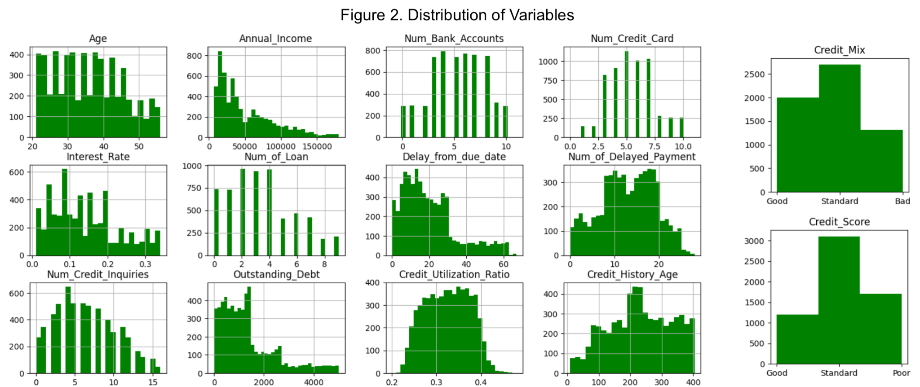
Data Pre-processing
Notes:
Anshi – information of the clean data and distribution of the variables

Slide 16
6,015 Observations
2 Categorical & 12 Numerical Variables
Notes:
Neri

Slide 17
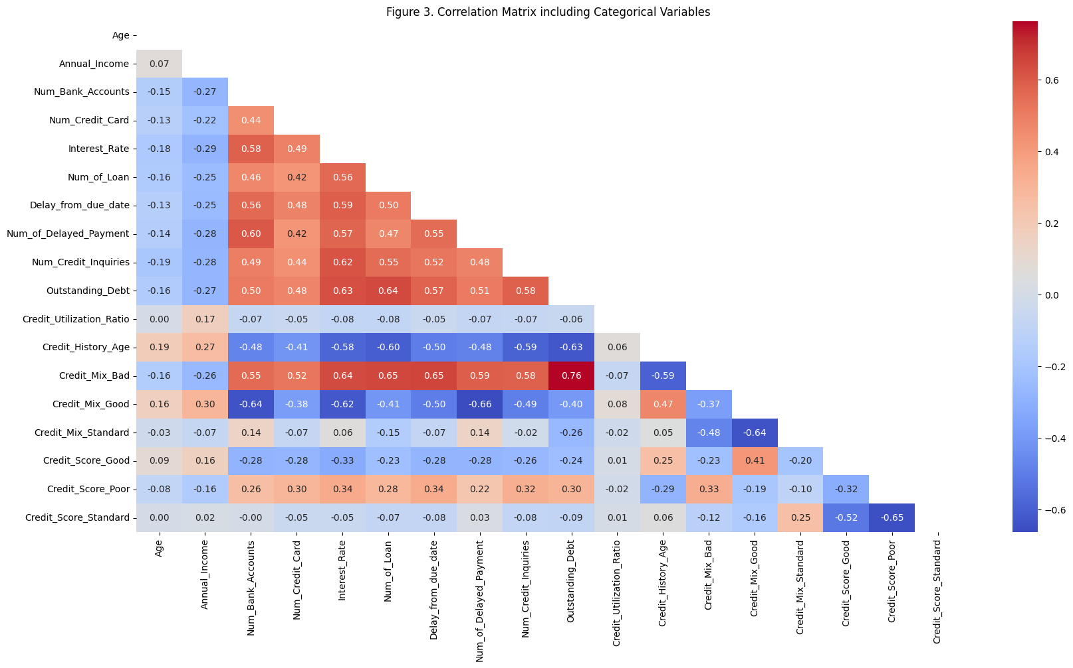
Correlations
Assumptions
Red Highlights
- Negative effects on Credit Score
Blue Highlights
- Positive effects on Credit Score
Notes:
Neri

Slide 18

3.
Methodologies
Bank of Questrom

Slide 19
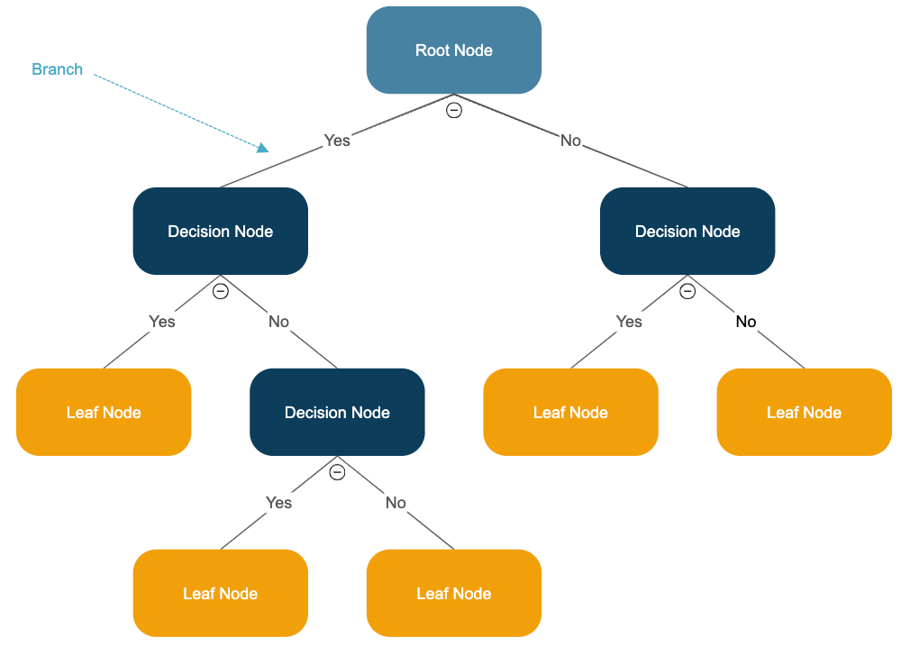
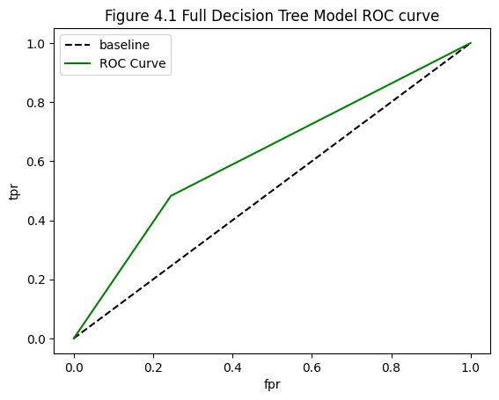
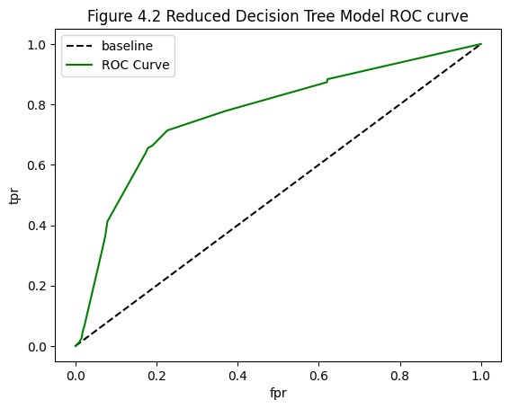
Decision Trees
What are the most important features in classifying someone with high credit risk?
Accuracy: 67.76%
Accuracy: 77.62%
Notes:
Michelle

Slide 20
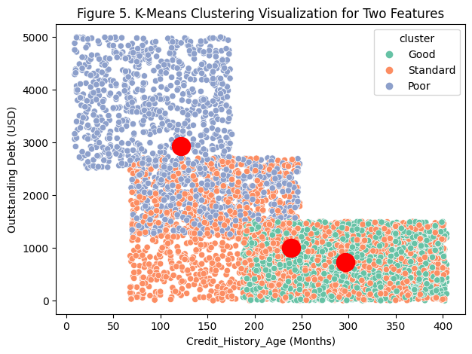
K-Means Clustering
What are the characteristics of an average customer with low credit risk or high credit risk?
Notes:
Anshi – utilized to compute the average features of each credit risk class.
– k which signifies the number of clusters = 3 and follows the three subjected credit score classes (Good, Standard, and Poor)
– The graph illustrates the three clusters and their centroids for outstanding debt, and credit history age.
– The clusters appear to overlap in the two dimensional figure because the k-means clustering was operated on multiple variables, thus producing multidimensional clusters

Slide 21

4.
Analysis
Bank of Questrom
Notes:
Michelle

Slide 22
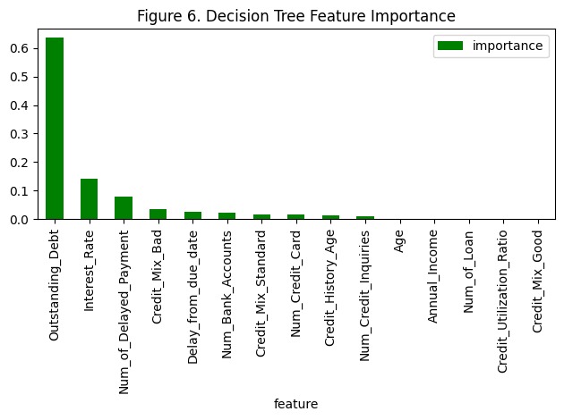
Decision Tree
Feature Importance
Outstanding_Debt
Interest_Rate
Num_of_Delayed_Payment
Delay_from_due_date
Num_Bank_Accounts
Num_Credit_Card
Num_Credit_Inquiries
Notes:
Michelle

Slide 23
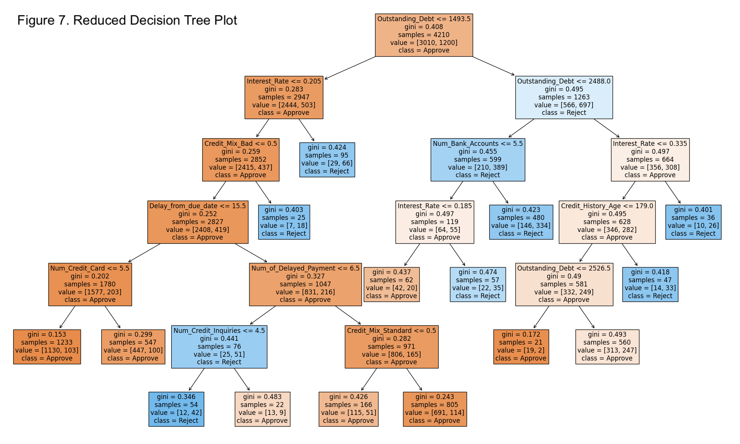
Decision Tree
Reduced Decision Tree
Outstanding debt higher than 2488 USD and interest rate higher than 34%.
Outstanding debt between 1493.5 and 2488 USD and the number of bank accounts higher than 5.5.
Notes:
Michelle
Our correlation assumption might be wrong, but this tree gives us an idea of how these features are affecting one’s credit risk (right hand side)
Our correlation assumption might also be right as this may be a error on the decision tree as the tree is showing a low sensitivity, with a smaller sample size (left hand side)

Slide 24
Notes:
Michelle

Slide 25
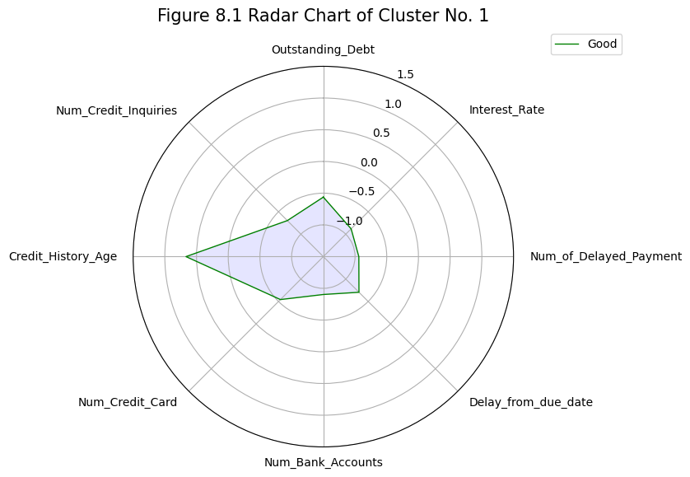
K-Means Clustering
Low Credit Risk
Higher average Credit_History_Age
Lower average for everything else
Notes:
David

Slide 26
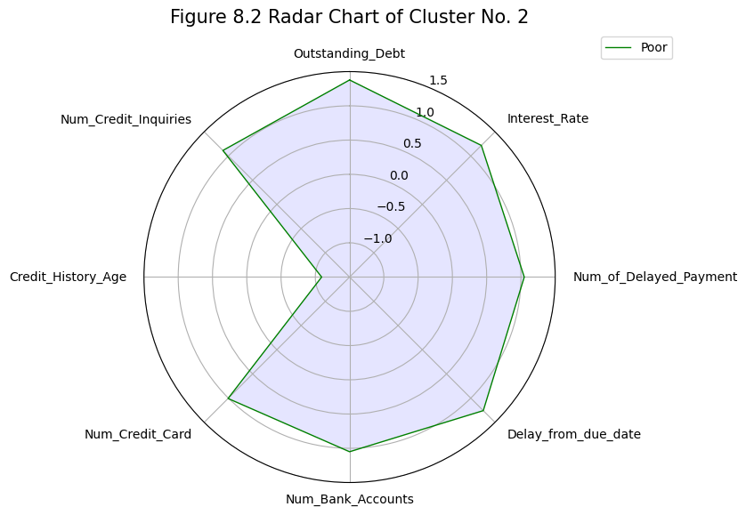
K-Means Clustering
High Credit Risk
Opposite of low credit risk
Lower average Credit_History_Age
Higher average for everything else
Notes:
David

Slide 27
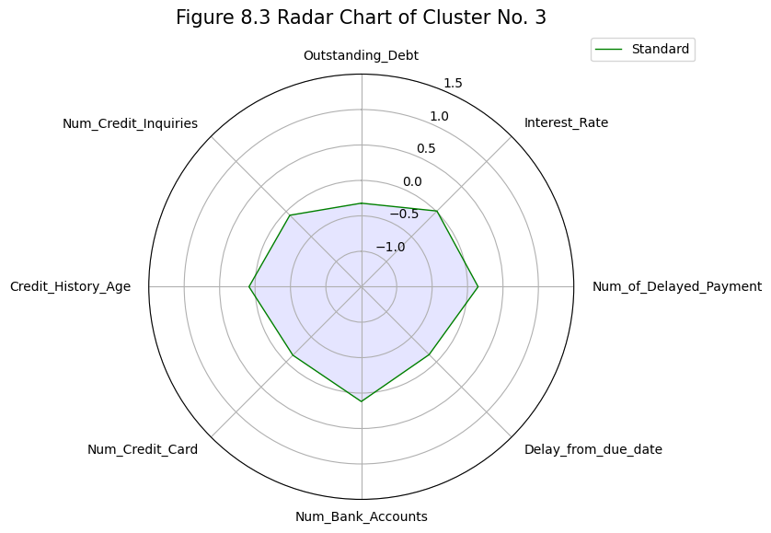
K-Means Clustering
Standard Credit Risk
In between low and high credit risk
Outstanding_Debt and Delay_from_due_date have the highest difference compared to high credit risk
Notes:
David

Slide 28

5.
Conclusion
Bank of Questrom
Notes:
David

Slide 29
Result
Amount of outstanding debt + interest rate ⇒ Most Important in identifying high credit risk!
Excessive number of delayed payments, accounts, credits, and inquiries ⇒ Can be red flag!
Lengthy credit history age ⇒ Good indicator of low credit risk.
But! Negative factors may diminish the positive influence of the credit history age.
Notes:
David

Slide 30
Optimal Benchmark
What are the optimal benchmarks for the application approval and rejection?
Reject the following criteria
(Debt amount > 1900 USD) & (Interest rate higher > 20%) & (Delay from due date > 28 days)
Notes:
David

Slide 31
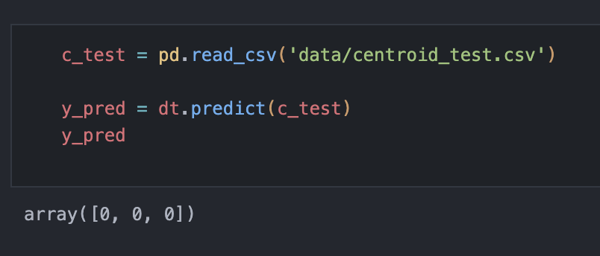
Testing the Evaluation Model
Unfortunately, the decision tree model was unable to identify the average person in the ‘high credit risk’ cluster.
Problem: Low sensitivity score
Only identifies extreme (polar) cases
Notes:
David

Slide 32
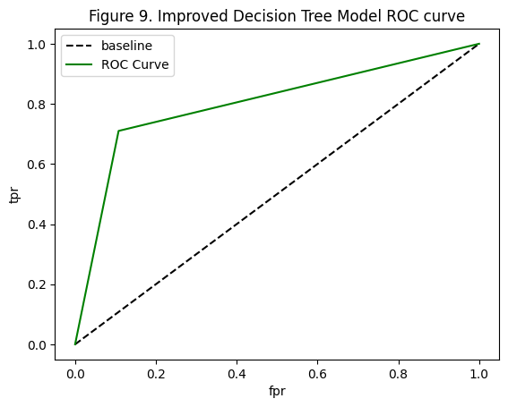
Improvement
Increased Data
Include all 8 months
6015 ⇒ 47,900 Observations
Accuracy
77.62% ⇒ 84.18%
F1 Score & Sensitivity
51.21% ⇒ 71.35%
41.25% ⇒ 71.01%
Notes:
David

Slide 33
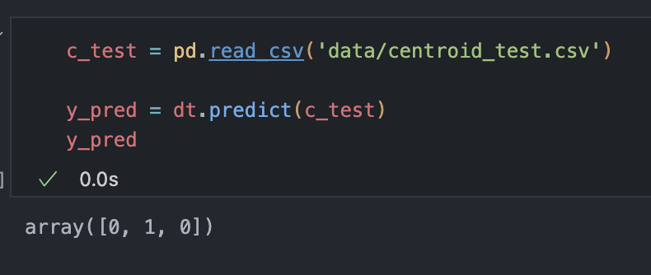
Success!
The improved evaluation model identified the
average individual within the ‘high credit risk’ cluster.
Notes:
David

Slide 34

Thanks!
Any questions?

Slide 35
Appendix
6.1 Codes
6.1.1 1_credit_data_cleaning.ipynb
Data cleaning file with the dependent variable ‘Credit_Score’ as a polytomous variable
Unique values of dependent variable: Good, Standard, Poor
6.1.2 1_credit_data_cleaning2.ipynb
Data cleaning file with the dependent variable ‘Credit_Score’ as a binary variable
Unique values of dependent variable: 0 (Includes Good and Standard), 1 (Poor)
6.1.3 2_credit_data_correlation.ipynb
File for finding correlations between variables via correlation matrix heatmap.
6.1.4 3_credit_knn.ipynb
KNN classification model with cleaned_credit_data.csv (Polytomous dependent variable)
6.1.5 3_credit_knn2.ipynb
KNN classification model with cleaned_credit_data2.csv (Binary dependent variable)
6.1.6 4_credit_decision_tree.ipynb
Decision tree model with cleaned_credit_data.csv (Polytomous dependent variable)
6.1.7 4_credit_decision_tree2.ipynb
Decision tree model with cleaned_credit_data2.csv (Binary dependent variable)
6.1.8 5_credit_kmeans.ipynb
K-means clustering with cleaned_credit_data.csv (Polytomous dependent variable)
6.1.9 experiment.ipynb
File for experimental improvement stage for the study
Increased number of observations by including all months instead of only ‘August’
Decision tree model with binary dependent variable
6.2 Data
6.2.1 credit_raw.csv
Original unprocessed data from the following url
https://www.kaggle.com/datasets/parisrohan/credit-score-classification
100,000 Entries with 28 columns
6.2.2 cleaned_credit_data.csv
Processed data with the dependent variable ‘Credit_Score’ as a polytomous variable
6015 Observations with 2 categorical and 12 numerical variables
6.2.3 cleaned_credit_data2.csv
Processed data with the dependent variable ‘Credit_Score’ as a binary variable
6015 Observations with 2 categorical and 12 numerical variables
6.2.4 centroids.csv
Centroids dataframe saved from ‘5_credit_kmeans.ipynb’
Standardized feature values of centroids within the three clusters
6.2.5 centroids_test.csv
Centroids dataframe used for testing the decision tree models
Unstandardized feature values of centroids within the three clusters

